Slide 1
ALTERNATE TO TRADITIONAL CREDENTIAL BASED AUTHENTICATION.
PIP104 PROFESSIONAL PRACTICE-II
VIVA-VOCE
Batch Number: CSE G156
Roll Number | Student Name
20201CSE0788 20201CSE0791 20201CSE0814 20201CSE0820 | Yeddula Nandini Sathela Haswitha Nafisa Fathima Chandana A.T
Under the Supervision of,
Ms. RAKHEEBA TASEEN
Professor / Associate Professor / Assistant Professor
School of Computer Science Engineering & Information Science
Presidency University

Slide 2
Introduction
PROBLEM STATEMENT:
Authentication is an activity to authenticate the person credential that wishes to perform the activity. In the process of authentication, the password enter by the user will be transmitted along the traffic to the authentication server to allow the server to grant access to the authorized user. When the password is transmitted, the attackers will try to sniff into the network to obtain data that include the user's password. Currently, there is rainbow table which able to trace the password with the hash algorithm to obtain the user's password. Once the password is succeeded to be decrypted, the attackers can use the user credential to do something illegal such as fraud others which will cause the user lost in credit. It is important to protect our own account because our credit is priceless.

Slide 3
Literature Review
EXISTING PROPOSED SOLUTIONS OVERVIEW
Authentication is a process to access to login account and accessing the service provided by the system or server using the password. It also has an alternative way to authenticate the user which is using biometric authentication by using fingerprint or iris recognition. However, human has the tendency to create easily remember password which it will lead to a problem. Authentication is the use of one or more mechanisms to confirm that you are the authenticated user. Once the identity of the human or machine is validated, access is granted. There are existing acknowledged three authentication factors are things the user knows, things the user have and biometric authentication. Biometric-based authentication is a good way to authenticate the user, but it is expensive and raises some privacy concern. One Time Passwords (OTP) offers a promising alternative for two-factor authentication systems.

Slide 4
A one-time password is a password that is valid for only one login session or transaction, on a computer system or other digital device. Two-factor authentication solution equips customers with a cost-effective means of providing flexible and strong authentication to very large scale. The goal of computer security to maintain the integrity, availability and privacy of the information entrusted to the system can be obtained by adopting this authentication technique. There are also company uses the hashing algorithm to store their password. In the transmission of the password, the password has already been hashed and become unreadable. Lastly, most of the password is now encrypted when it is sent from the sender to the receiver. The password is encrypted so that the attackers will not easily obtaining the correct password since they will need another step to decrypt the data.

Slide 5
TWO FACTOR AUTHENTICATION:
Two-factor authentication has been introduced long time ago. It is also known as the two-step verification. The organization will implement this method because it is easy the implement it. They can save the cost from replacing the existing system and increase security level by adding a layer of security that protects the existing authentication system. The reason for the two-factor authentication has been started to use by many organizations is because of the ease of implementation of the method. They do not require to replace the existing system but just increase security level by adding a layer of security that protects the existing authentication system. The process will require 2 reliable authentication factors which is something the users knows such as alphanumeric password, something user has such as the phone and something the user is such as biological unique features (e.g. Fingerprint). Two-factor authentication is an evolvement from single-factor authentication which only requires the password of the user.

Slide 6
However, single-factor authentication is no longer secure due to user tends to have the weak password which is common. Users also tend to have the same password for multiple accounts. This provides a chance for the hacker to succeed in password exploitation. The two-factor authentication helps to provide an additional layer of security. In two factor authentication, the user provides dual means of identification, one of which is typically a physical token, such as a card and the other of which is typically something memorized, such as security code. The aim of the multifactor is to create a more difficult step for attackers/ unauthorized people to access a target. This mechanism still able to be secure if there is still existing a barrier to breach before accessing the target.

Slide 7
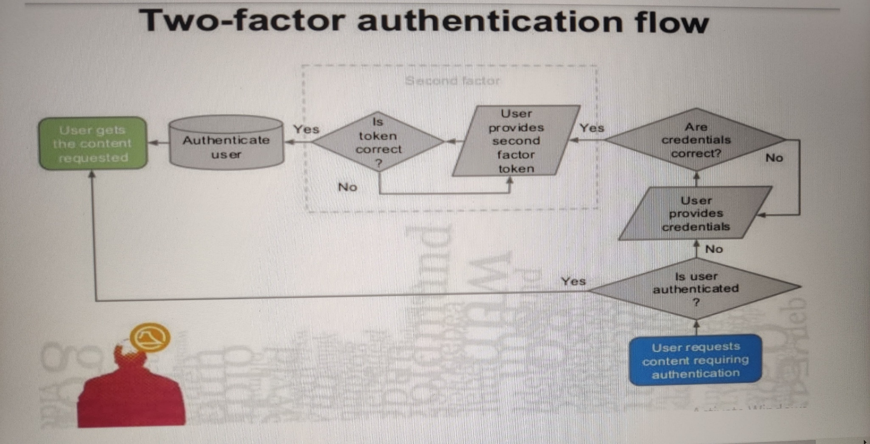

Slide 8
ONE TIME PASSWORD (OTP):
A one-time password is a password that is valid for only one login session or transaction, on a computer system or other digital device. The OTP authentication main idea is to provide infinite factors and create different password every time during user logging in to improve the security of the system. OTP is used in conjunction with a token. The token and corresponding authentication server share the same algorithm. The algorithm is different for each user's token to prevent attackers break the algorithm. Several OTP systems also aim to ensure that a session cannot easily be intercepted or impersonated without knowledge of unpredictable data created during the previous session, thus reducing the attack surface further. The OTP authentication system is implemented by two main mechanisms. The first mechanism is the challenge-response mode. The system will generate a challenge to the user when the user is logging in. The OTP is generated by combining user keyed in the password and challenge generate by the system.

Slide 9
The user will need to key in the OTP to log in successfully. The next mechanism is time synchronization. This mechanism will use the user login time to generate the random number. The user can generate the password combining his passphrase. OTP also only valid for a short period of time only.
CRYPTOGRAPHY
Cryptography is the study to generate the secret message between the sender and the receiver.
Encryption is a process that converts the message into unreadable using some algorithm.
Encryption is a process to convert plaintext into the ciphertext.
Decryption is the vice versa of the encryption which will convert the data into the meaning form.
It is a process to transform ciphertext into plain text.

Slide 10
Proposed Methodology
DESIGN SPECIFICATIONS:
Due to the importance to secure the password, I had implemented an enhanced version of the login authentication from the existing proposed solution.
This project needs 2 things which are the desktop sites and mobile application. The desktop designed to have 2 type of user input with username and OTP. The website will require the username first then only the password. Next, the system will need the implementation of server side scripting. The server-side scripting will retrieve the password from database and generate the random key with 48 characters. The password and random key then combine and hashed. For the mobile application part, the user interface design is important to help the user to understand the step to use it. The application will then prompt the user password and the OTP will be generated.

Slide 11
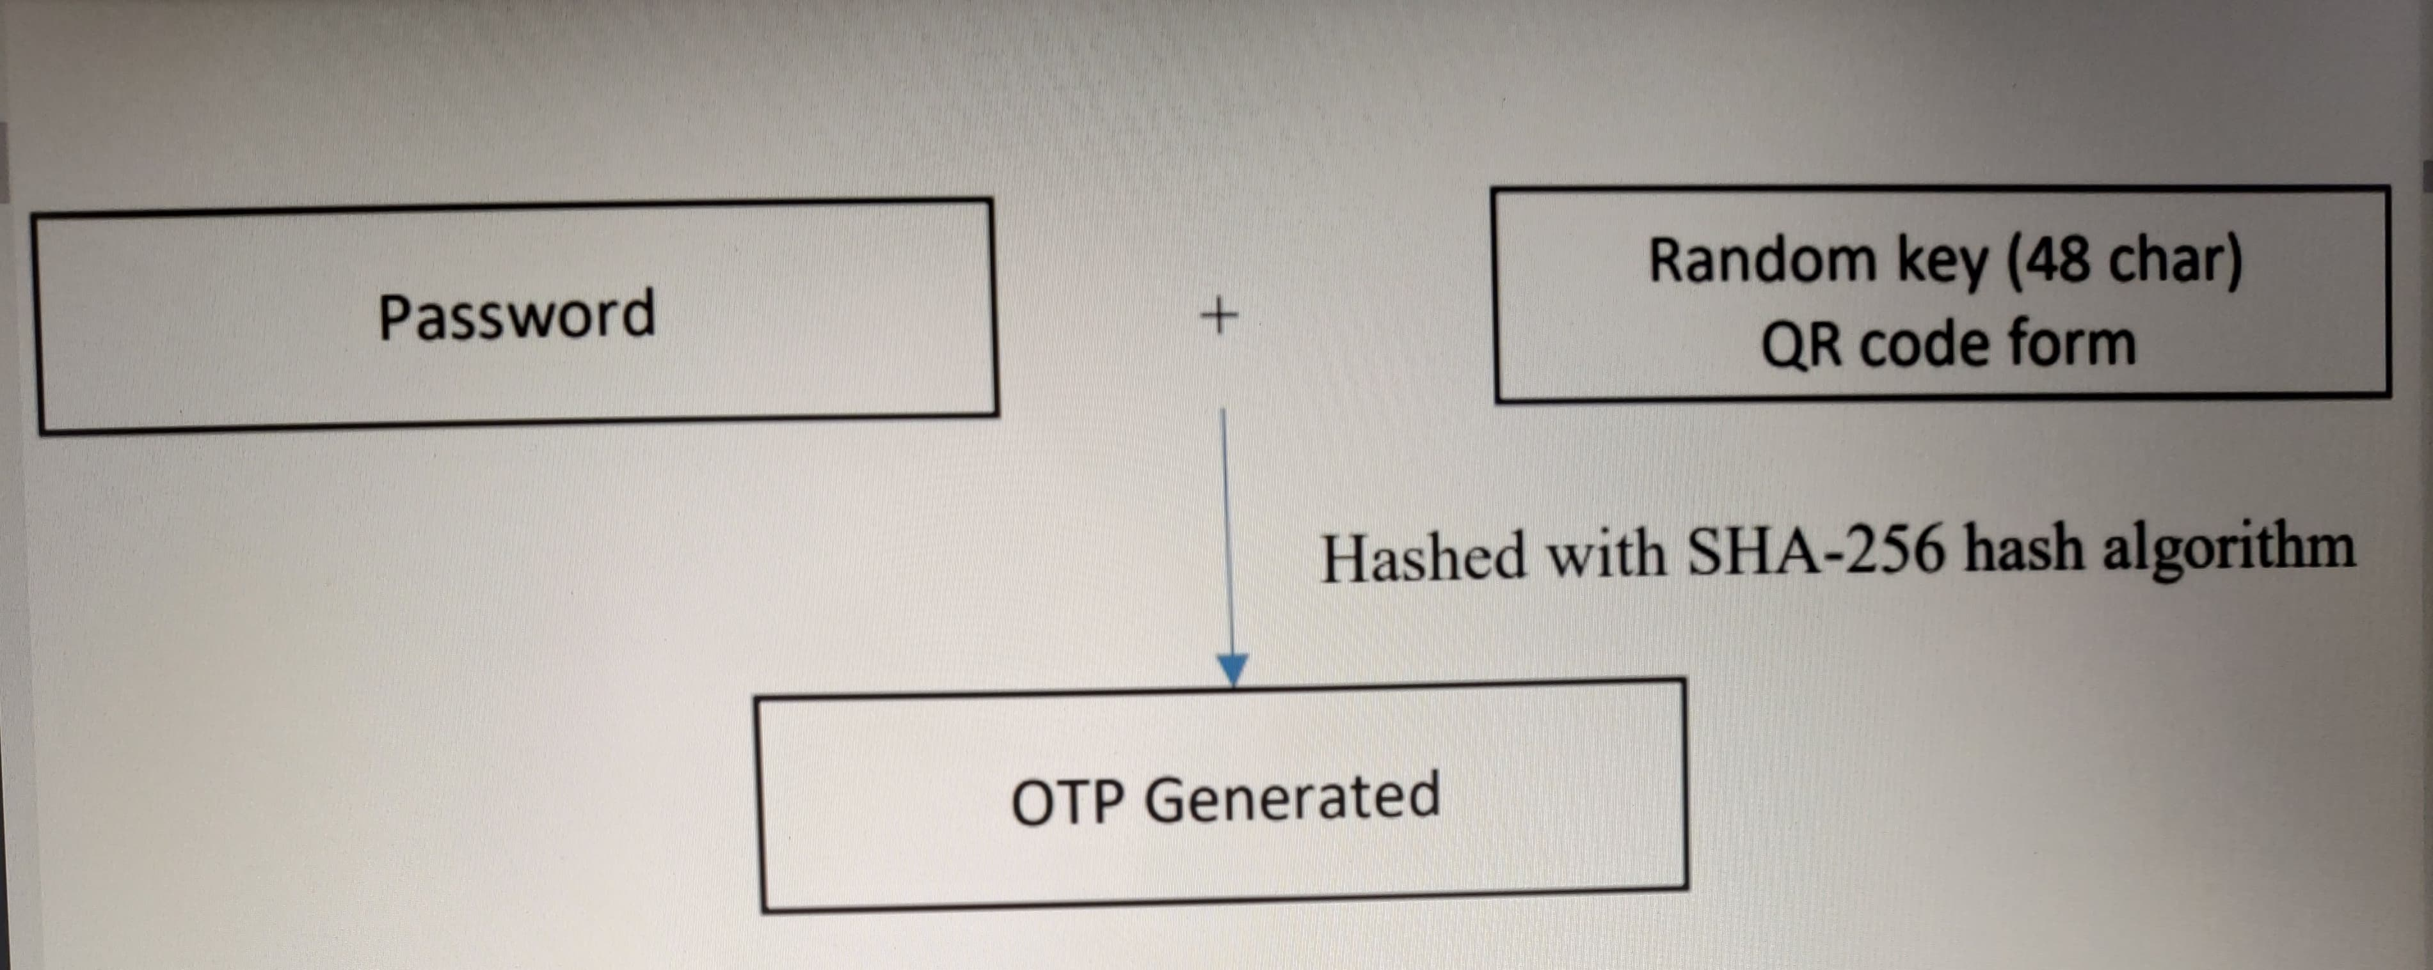
To overcome the problem in the currently existing system, the server will generate a different random key in each time when the user logs in to the system to generate the OTP. So, the attackers will not be possible to obtain the actual password.

Slide 12
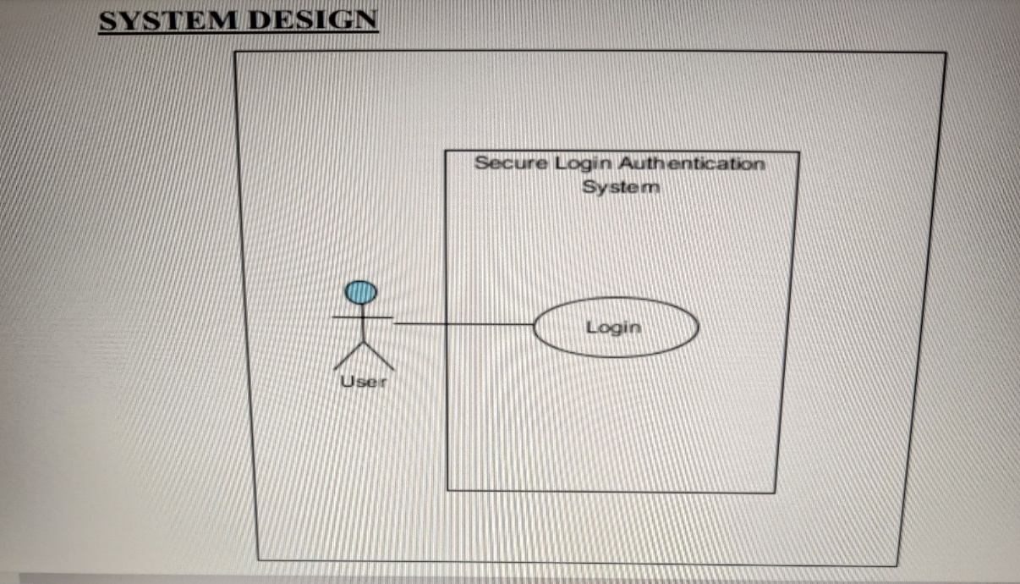
SYSTEM DESIGN:
The system start with the user wants to surf the web and perform the login activity. The user key in their own username and click next. The system will search the username in the database. The system will send an error message if the username does not exist in the database. Once if the username is valid in the database, the website will display the login phrase of the user. This method needs to do so to protect.

Slide 13
Objectives
The 4 main objectives for this project:
The main objective is to implement a secure login authentication system with utilizing with two-factor authentications. By using the concept two-factor authentication could help to increase the strength of the login system. The attacker will need to pass through the next barrier of defense to success to log in. This system will help to enhance the login authentication system.
Next objective is to ensure login password will not be transmitted over the network. As compared to the previous solution, the password is just encrypted, but the attackers might succeed to decode the data and retrieve the password. So, to prevent this happens, the password with the random key will need to be hash before the sender sends the password to the server. It is important to secure the password of the user.

Slide 14
3. Apart from that, the third objective will be to generate the one-time password offline. This will help in perform the login procedure if there is a limited connection of wi-fi or mobile signal is weak. It will help the user who lives in the countryside which has a weak phone signal.
4. Lastly, the fourth objective is to ensure the system is protected from rainbow table attack. The rainbow table will act as a dictionary store and optimised for hashes and password. So once the random key is repeated, the password will be retrieved. So, the random key should be long enough to cause the attackers to use a longer time to generate the rainbow table.

Slide 15
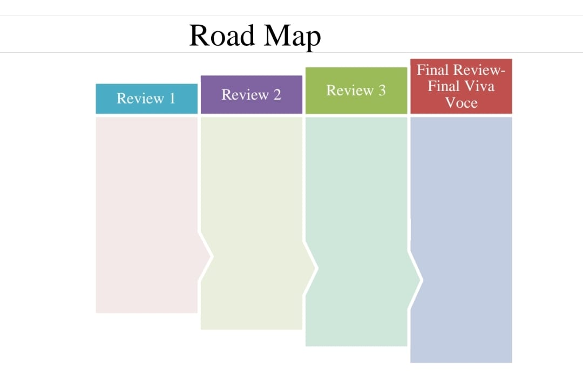
Timeline of Project

Slide 16

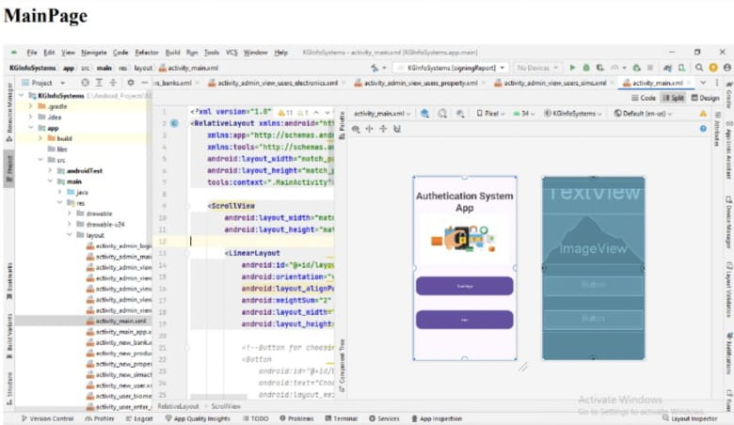
Outcomes / Results Obtained

Slide 17
Conclusion
Traditional credential-based authentication has been widely used for many years, but it has several limitations and challenges. Weak passwords, password reuse, and forgotten passwords are common issues that lead to security vulnerabilities. Social engineering attacks and credential theft further exacerbate the risks associated with traditional authentication methods. User inconvenience and password fatigue are also significant drawbacks of traditional credential-based authentication. Users struggle to remember complex passwords for multiple accounts, leading to frustration and potential security risks. Regular password changes and the introduction of two-factor authentication (2FA) add further complexity and inconvenience for users. Overall, traditional credential-based authentication has its place, but it is increasingly important to adopt more secure and user-friendly authentication methods to address the ever-evolving landscape of cybersecurity threats.

Slide 18
References
[1] R. Anderson, Security Engineering: A Guide to Building Dependable Distributed Systems, 2nd ed. New York: Wiley, 2008
[2] R. G. Rittenhouse, J. A. Chaudry, and M. Lee, “Security in Graphical Authentication,” Int. J. Secure. Its Appl., vol. 7, no. 3, pp. 347–356, 2013.
[3] K. I. P. Patil and J. Shimpi, “A Graphical Password using Token, Biometric, Knowledge Based Authentication System for Mobile Devices,” Int. J. Innov. Technol. Explore. Eng., vol. 2, no. 4, pp. 155– 157, 2013.
[4] A. H. Lashkari, S. Farmand, D. O. Bin Zakaria, and D. R. Saleh, “Shoulder Surfing attack in graphical password authentication,” Int. J. Compute. Sci. Inf. Secure., vol. 6, no. 2, p. 10, Dec. 2009.
[5] K. Renaud, “On user involvement in production of images used in visual authentication,” J. Vis. Lang. Compute., vol. 20, no. 1, pp. 1–15, Feb. 2009.

Slide 19

Thank You

